Slide 1
Applying Artificial Neural Networks to Reduce the Adaptation Space in Self-Adaptive Systems
- an exploratory work
Author: Sarpreet Singh Buttar
Supervisor: Prof. Danny Weyns
Notes:
My thesis title is applying artificial neural networks to reduce the adaptation space in self-adaptive systems. It is an exploratory work because artificial neural networks has not been explicitly used to reduce the adaptation space.

Slide 2
Self-Adaptation
Modern Software systems deal with various runtime uncertainties:
Dynamic conditions of the operating environment
Changing user goals
Runtime uncertainties affect quality requirements
Self-adaptation autonomously handles runtime uncertainties
Various approaches to realize self-adaptation:
Architecture-based adaptation
Self-aware computing
Context-based software adaptation
Notes:
Modern software systems are subject to various types of uncertainties. The most challenging ones are runtime uncertainties because they are unpredictable before deployment and can affect the quality requirements of a system. To tackle runtime uncertainties, software engineers have proposed one prominent approach called self-adaptation. Self-adaptation enables a software system to autonomously handles runtime uncertainties to accomplish particular quality requirements. Software systems with such behavior are called self-adaptive systems. There are various approaches to realize self-adaptation and we focus on architecture-based adaptation.

Slide 3
Architecture-Based Adaptation
Managed system contains domain logic
Managing system contains adaptation logic
Communicates via sensors & actuators
Notes:
This approach decomposes the self-adaptive system in to a managed system and a managing system. The managed system is the software system that contains the domain logic and is subject to adaptation. Whereas, the managing system holds the adaptation concerns of the managed system. These systems communicate with each other via sensors and actuators.

Slide 4
Architecture-Based Adaptation
Managing systems is equipped with MAPE-K feedback loop
MAPE-K feedback loop is used to realize self-adaptation
Notes:
The managing system uses a MAPE-K feedback loop to achieve the quality requirements of the managed system. The MAPE-K feedback loop consists of five components named as monitor, analyzer, planner, executor and knowledge. These components work in a loop.

Slide 5
Architecture-Based Adaptation
Runtime models: managed system & environment models
Runtime models have parameters to capture data
Adaptation options: a set of possible configurations, a.k.a. adaptation space
Adaptation goals: quality requirements
Adaptation plan: a set of instructions to adapt managed system
Notes:
The monitor collects runtime data from the managed system and its operating environment via sensors and updates runtime models with the collected data. Then it triggers the analyzer that uses runtime models to analyze the qualities of the adaptation options. Then the analyzer triggers the planner that selects the best adaptation option based on the adaptation goals and creates and adaptation plan for it. Then it triggers the executor that adapts the managed system by executing the adaptation plan via actuators. The knowledge is a repository shared by the monitor, analyzer, planner and executor to maintain their data.

Slide 6
Existing Formal Analysis Approaches (ActivFORMS, RQV)
Monitor, planner & executor work same
Model checker estimates quality requirements with all adaptation options
Quality model represents the managed system for a specific adaptation goal
Provide guarantees to achieve adaptation goals
Notes:
ActivFORMS, RQV are the existing formal analysis approaches in architecture-based adaptation. These approaches use a model checker that estimates the quality requirements of the system with all the possible adaptation options. It estimates the quality requirements by simulating each quality model with each adaptation option. A quality model represents the managed system and its environment for the quality requirement which is subject to adaptation. Due to exhaustive analysis, these approaches are able to find the best adaptation option and hence provide guarantees to achieve the adaptation goals at runtime

Slide 7
Research Problem & Research Question
Self-adaptive systems have limited time
Existing formal analysis approaches use exhaustive analysis
Exhaustive analysis needs time and computing resources
May not be feasible on large adaptation space (1000s adaptation options)
Only efficient in small-scale self-adaptive systems
Can we use artificial neural networks to reduce the adaptation space in self-adaptive systems without compromising the adaptation goals?
Notes:
Every self-adaptive system has an adaptation space that contains all the possible adaptation options. Whenever runtime uncertainties violates the adaptation goals, it has limited time to adapt itself. Within the available time, it needs to analyze the adaptation space to find the best adaptation option that can achieve the adaptation goals. Existing formal analysis approaches determines the best adaptation option by exhaustively analyzing the entire adaptation space. However, exhaustive analysis on large adaptation space, i.e., 1000s adaptation options, within limited time may not be feasible. Thus, formal analysis approaches are only efficient in small-scale self-adaptive systems. We formulate the research problem in to one research question.. Concretely, we aim to apply learning in such a way that it can reduce the adaptation space to only those adaptation options that are relevant to the current runtime uncertainties. It would allow formal analysis approaches to efficiently deal with large adaptation spaces by only analyzing the relevant adaptation options.

Slide 8
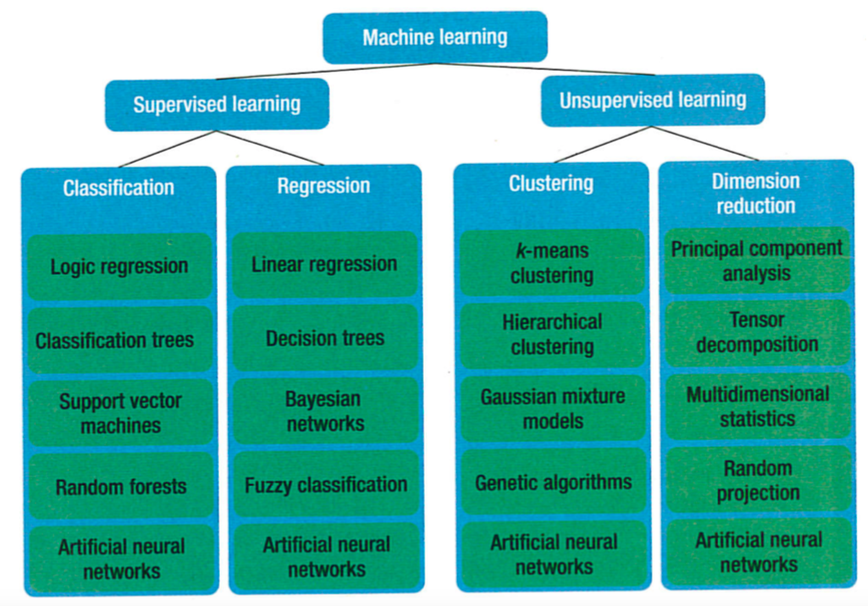
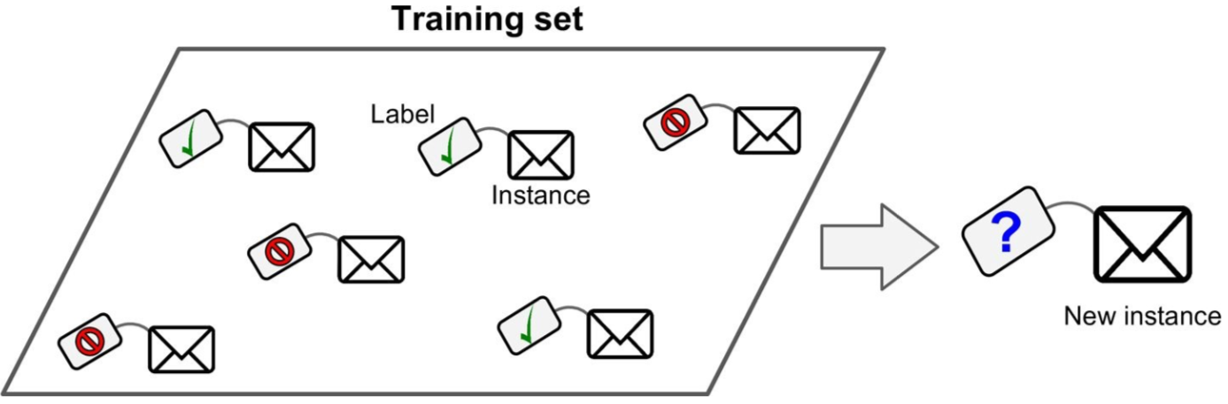
Machine Learning
Classification
Notes:
ML is a study of algorithms that enable a computer to learn from data. It uses mathematical techniques (statistical, probabilistic) to interpret and make predictions about the data. ML has two sub-branches and we focus on supervised learning in which computer learns from the labelled examples under the human supervision. This mechanism is fundamentally different from the traditional programming approach where rules are explicitly programmed. In supervised learning, we can train the computer either offline or online. We do online learning since we deal with runtime uncertainties which are unpredictable before the deployment. The online learning learning enables the computer to continuously learn in an uncertain environment. Moreover, it is considered to be the best practice in autonomous systems. Within supervised learning, we target classification approach in which computer learn to predict the label of new instances. Within classification, we focus on artificial neural networks.

Slide 9
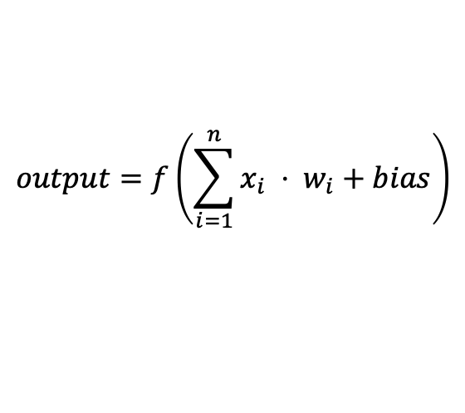
Artificial Neural Networks (ANN)
First introduced in 1943
Mimic the behavior of a biological neuron
Various ANN:
Multi-layer perceptron (MLP)
Recurrent
MLP is feed-forward neural network
Activation function is used to produce output
$$output=f\left(\sum_{i=1}^{n}{x_{i} ⋅ w_{i}+bias}\right)$$
Notes:
ANN were first introduced in 1943 as a computation model that uses propositional logic to mimic the behavior of a biological neuron. Since, then many ANN were introduced and we focus on multilayer perceptron. MLP is one of the most commonly used ANN. It consists of one input layer, one or more hidden layers, and one output layer. MLP is also knows as a feed-forward neural network, since the input data travels in one direction, from the input to output layer. The input layer captures the features of a given sample and pass them to the hidden layers. The neurons in the hidden layers use an activation function to produce the output. An activation function is a simple mapping of summed weighted input to the output of the neuron. Tanh, logistic and relu are some of common activation functions to map non-linear data. The output of the neurons is served as input to the neurons in the next layers. The output layer predicts the label of the given sample. Every layer except output layer contains a bias neuron. The output of the bias neuron is always 1. bias neurons are helpful to shift the boundary decision of an activation function to left or right. Hence, in this way MLP learns a function to map a given input to an output

Slide 10
Our Learning Approach
Embeds machine learner component in managing system
Monitor, planner & executor work the same
Analyzer is connected with a machine learner & model checker
Machine learner selects relevant adaptation options
Model checker verifies relevant adaptation options
Notes:
We embed a new component called machine learner in to the managing system so that it can integrate with the MAPE-K feedback loop. The monitor, planner and executor works the same as before. The analyzer connects with the machine learner and model checker. The machine leaner supports the analyzer by selecting a subset of the adaptation options which are valid in the current situation. For selecting the subset, the machine learner uses learning models which are placed in the knowledge repository. The analyzer then uses the model checker to further verify the selected subset. The machine learner component is generic. Therefore any online learning approach such as classification and regression can be used.

Slide 11
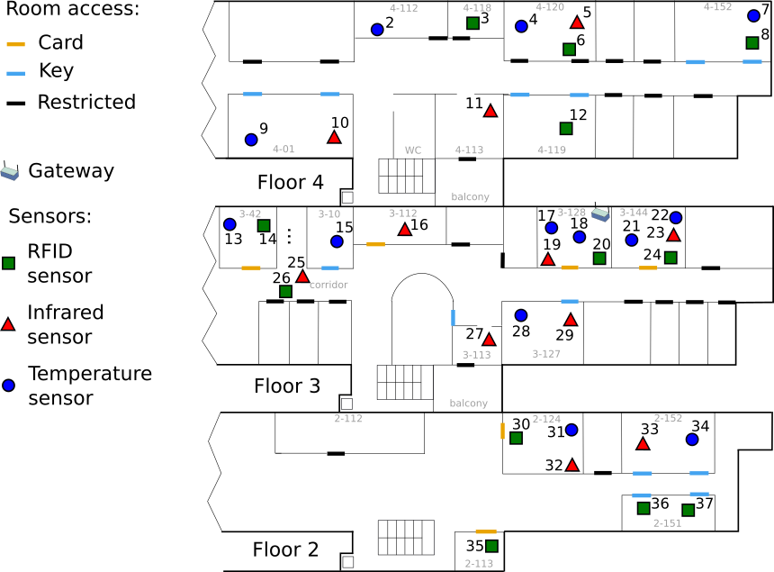
DeltaIoT: An Internet of Things System
DeltaIoT.v2
DeltaIoT.v1
15 motes, adaptation options=216, analysis time=570 sec
37 motes, adaptation options=4096, analysis time=570 sec
Adaptation Goals:
Average packet loss < 10%
Average latency < 5%
Minimum energy consumption of the motes
Runtime uncertainties:
Interference in the network
Dynamic load on the motes
Deployed at KU Leuven, Belgium
Notes:
For the evaluation of our approach, we considered an IoT application with two different use cases. DeltaIoT is a research artifact introduced by my supervisor and his team in 2017. It simulates a smart mesh network which is deployed at the computer science department of KU Leuven university. The first use case is DeltaIoT.v1 that consist of 15 different types of motes, eg heat sensor, passive infrared and RFID sensors. The motes are connected via a wireless link. The motes sends the sensing data to the gateway. DeltaIoT.v1 has 216 adaptation options and 570 seconds to analyze them. The second use case is DeltaIoT.v2 that consist of 37 motes, 4096 adaptation options and 570 seconds for analysis. Its adaptation space is much bigger than DeltaIoT.v1. in both cases there are two runtime uncertainties…, similarly the adaptation goals in both cases are…. We aim to achieve the adaptation goals in both cases under given runtime uncertainties.

Slide 12
Methodology
Two controlled experiments on DeltaIoT.v1 & DeltaIoT.v2:
Independent variables:
ActivFORMS (no learning approach)
Our learning approach
Dependent variables:
Adaptation goals (packet loss, latency, energy consumption)
Adaptation space
Analysis time
Adaptation time
Notes:
We performed two controlled experiments for the evaluation of our learning approach. The independent variables are ActivFORMS, and our learning approach and the dependent variables which are the adaptation goals, space, analysis time and adaptation time.

Slide 13
Results – DeltaIoT.v1
On Average | Learning | No Learning
Packet Loss (%) | 7.6 | 8.4
Latency (%) | 0.4 | 0.7
Energy Consumption (coulomb) | 12.7 | 12.7
Adaptation Space | 51 (76%) | 216
Analysis Time (sec) | 5 | 26
Adaptation Time (sec) | 5 | 26

Slide 14
Results – DeltaIoT.v2
On Average | Learning | No Learning
Packet Loss (%) | 8.8 | 9.0
Latency (%) | 0.6 | 1.0
Energy Consumption (coulomb) | 66.5 | 66.5
Adaptation Space | 293 (92%) | 2825 out of 4096
Analysis Time (sec) | 48 | 570
Adaptation Time (sec) | 48 | 570

Slide 15
Results – Learning Models Time Measurements
DeltaIoT.v1
DeltaIoT.v2
Notes:
It is worth to mention that in the learning approach, the learning models have almost no overhead on the analysis and adaptation time since they take a tiny amount of time, i.e., <1 second on average, for training and predictions.

Slide 16
Threats to Validity
Simulation randomness may imposes reliability threat
Minimized by running longer simulation
Evaluation introduces external validity threat
Conclusion may not be generalized in other domains
Need more evaluations from different domains
Notes:
Due to pragmatic reasons, we use simulation to evaluate our approach. The simulation produces runtime uncertainties by following specific types of randomness. Therefore, randomness may impose a reliability threat that might slightly change the evaluation results if the experiments are repeated. However, we minimize this threat by running the simulation for several days. On the other hand, we evaluate our approach on a specific application of the IoT domain. It introduces an external validity threat because our conclusion may not be generalized in other domains. Hence, to reduce this threat, we require more evaluations from different domains.

Slide 17
Conclusion & Future Work
ANN efficiently reduced the adaptation space
Adaptation goals are still guaranteed
Our contribution to the state-of-the-art is a learning approach
Enable formal analysis approaches to handle large adaptation space
Used IoT system for evaluation
In future:
Evaluation on other self-adaptive artifacts
Explore other neural networks and approaches within supervised learning
Integrate with other existing formal analysis approaches
Achieve optimization goals using machine learning
Notes:
In this thesis, we examined whether ANN can be used to reduce the adaptation space in self-adaptive systems without compromising the adaptation goals. Based on our results, we can confirm that it is indeed possible. Our contribution to the state-of-the-art is a learning approach that integrates with the MAPE-K feedback loop and continuously learns the adaptation space on-the-fly. The continuous learning enables the learning models to efficiently reduce the adaptation space to a subset of relevant adaptation options. Our approach enables formal analysis approaches to efficiently analyze large adaptation spaces without compromising quality guarantees. We demonstrated the effectiveness of our approach on two different instances of an IoT application. In the future, we aim to determine the generalization of our approach, we plan to apply it on different self- adaptive artifacts developed by the community. Second, we plan to explore other types of ANN and approaches in supervised learning. Third, we plan to evaluate our approach against other existing formal analysis approaches such as RQV.

